Slide 1
Chapter 5 Using Classes and Objects in Media Computing
Fundamentals of Java: AP Computer Science Essentials, 4th Edition
Lambert / Osborne

Slide 2
Objectives
Use the concepts of object-based programming—classes, objects, and methods—to solve a problem.
Write a loop to visit a sequence of data values.
Write a nested loop to visit positions in a two-dimensional grid of data values.
‹#›
‹#›

Slide 3
Objectives (continued)
Develop algorithms to perform simple transformations of images, such as the conversion of color to gray scale.
Develop algorithms to perform simple transformations of sound clips, such as adjusting a sound clip’s volume.
‹#›
‹#›

Slide 4
Vocabulary
accessors
application programming interface (API)
aspect ratio
default constructor
edge detection
enhanced for loop
mutators
object instantiation
object recognition
row-major traversal
‹#›
‹#›

Slide 5
Vocabulary (continued)
sampling rate
screen coordinate system
sound clip
splicing
‹#›
‹#›

Slide 6
Introduction
Objects give programmers access to complex behavior.
Objects can manipulate digitally encoded images and sounds.
Until 20 years ago, computers mostly processed numbers and text.
Now, computers are multimedia platforms, including digital music players and cameras.
‹#›
‹#›

Slide 7
Introduction to Digital Image Processing
Digital image processing includes:
Capturing images with scanners and cameras.
Representation and storage or images in efficient file formats.
Construction of algorithms used in image-manipulation programs.
Adobe Photoshop
‹#›
‹#›

Slide 8
Introduction to Digital Image Processing (continued)
The Essential Properties of Images:
When an image is loaded in a program, the bits map into a rectangle of colored dots (pixels).
The coordinates of the grid range from:
(0,0) at the upper right corner to (Width -1, Height -1) at the lower-right corner.
Width and height are the dimensions in pixels.
X-coordinates increase positively to the right, y-coordinates increase positively to the bottom.
‹#›
‹#›

Slide 9
Introduction to Digital Image Processing (continued)
The Essential Properties of Images (cont):
An image consists of a width, height, and a set of pixels.
Each pixel is accessible by its (x,y) coordinates.
A pixel contains integer values that represent color in terms if red, green, and blue (RGB).
‹#›
‹#›

Slide 10
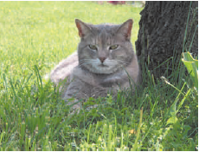
Introduction to Digital Image Processing (continued)
The Essential Properties of Images (cont):
The pixel at the upper-left corner is at (0,0) and has RGB components 206, 224, and 122.
An image with a width of 300 pixels and a height of 225 pixels
‹#›
‹#›

Slide 11
Introduction to Digital Image Processing (continued)
Image-Manipulation Operations:
Transfer images to and from files and storage in RAM.
After loading into RAM, can retrieve or modify a pixel at any grid position.
‹#›
‹#›

Slide 12
Introduction to Digital Image Processing (continued)
Image-Manipulation Operations (cont):
These operations allow the program to:
Rotate an image.
Convert color to gray scale or apply color filtering.
Highlight, blur, or sharpen all or part of an image.
Control brightness and perform edge detection.
Enlarge or reduce size and apply color inversion.
Morph an image into another image.
‹#›
‹#›

Slide 13
The images Package
The images package defines classes that allow the programmer to:
Load an image from a file.
View the image in a window.
Examine and manipulate an image’s pixels.
Update the window with changes.
Save the image back to a file.
‹#›
‹#›

Slide 14
The images Package (continued)
The APImage and Pixel Classes:
The two most important classes in the images package.
APImage methods include:
Creating an image from a file, or a blank image.
Returning image’s height and width.
Saving the image.
‹#›
‹#›

Slide 15
The images Package (continued)
The APImage and Pixel Classes (cont):
The Pixel class represents a pixel.
An object of this class contains three integer values to represent RGB.
Methods include:
Creating a pixel and specifying RGB values.
Returning and resetting the red, green, or blue values.
Returning a copy of the pixel.
Returning a string representation of the pixel (RGB values).
‹#›
‹#›

Slide 16
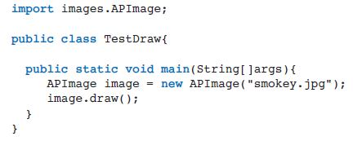
The images Package (continued)
The Structure of a Simple Image-Processing Program:
A program that loads an image (smokey.jpg) from its file and draws it in a window:
‹#›
‹#›

Slide 17
The images Package (continued)
The Structure of a Simple Image-Processing Program (cont):
The first statement imports the relevant class, APImage, from the images package.
The second statement uses object instantiation to make a new object available to the program and instantiates the class.
The third statement runs the draw method on the object to display it in a window.
‹#›
‹#›

Slide 18
The images Package (continued)
Working with Large Images:
Java might raise an error if there is not enough RAM to hold an image.
Heap space: the area of RAM reserved for Java objects.
To prevent a crash, adjust the heap space for data memory using the Xmx command-line option.
‹#›
‹#›

Slide 19
The images Package (continued)
Interfaces, Object Instantiation, and Object-Based Programming:
Object-based programming uses existing classes, objects, and methods to solve problems.
To use an object, the programmer must know its interface (the set of methods it recognizes).
‹#›
‹#›

Slide 20
The images Package (continued)
Interfaces, Object Instantiation, and Object-Based Programming (cont):
An interface contains the headers of methods and supporting comments about their use.
Including methods’ names, types of parameters they expect, and types of values they return, if any.
No information about how methods work.
Application programming interface (API): the set of interfaces in a package or language.
‹#›
‹#›

Slide 21
The images Package (continued)
Interfaces, Object Instantiation, and Object-Based Programming (cont):
Mutators: methods that do not return a value.
Used to modify the internal contents of an object.
setPixel and setRed
Accesors: methods that return values.
Allow users to examine part of an object’s contents.
toString( ) returns a strong representation of the data contained in an object.
‹#›
‹#›

Slide 22
The images Package (continued)
Interfaces, Object Instantiation, and Object-Based Programming (cont):
Constructors have no return type.
A constructor is called when a new object of a given class is created or instantiated.
Some constructors can receive information in the form of parameters from the caller.
Default constructor has no parameters.
When used, the object’s internal state is given reasonable default values.
‹#›
‹#›

Slide 23

The images Package (continued)
Examining the Attributes of an Image or a Pixel:
getWidth and getHeight return the width and height of an image.
Code to print an image’s strong representation:
‹#›
‹#›

Slide 24

The images Package (continued)
Examining the Attributes of an Image or a Pixel (cont):
When a variable that refers to an object is passed as a parameter to System.out.print or println, the method automatically calls that object’s toString method to obtain its string representation.
A simpler way to print the string representation of the image:
‹#›
‹#›

Slide 25

The images Package (continued)
Examining the Attributes of an Image or a Pixel (cont):
The method getPixel returns the Pixel object at the given coordinates.
Code to print the information for the pixel at position (0,0):
The method getPixel returns a Pixel object, which is fed to the println method, then calls the toString method of the Pixel class, which returns the pixel’s string representation.
‹#›
‹#›

Slide 26
The images Package (continued)
Modifying the Attributes of an Image or a Pixel:
You can use the setPixel method to replace an RGB value at a given position in an image.
Code draws a new 150 by 150 black image, then redraws the image with red pixels along a horizontal line at the middle of an image.
‹#›
‹#›

Slide 27
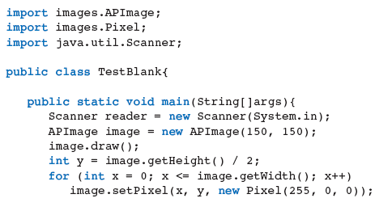

The images Package (continued)
Modifying the Attributes of an Image or a Pixel (cont):
‹#›

Slide 28
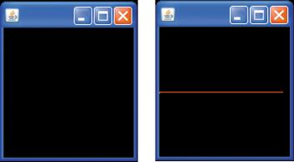
The images Package (continued)
Drawing a red line segment through an image.
‹#›
‹#›

Slide 29

The images Package (continued)
Using an Enhanced for Loop to Visit Pixels:
An enhanced for loop or for-each loop:
Assumes you want to visit each element in the data structure for some purpose.
On each pass, the loop variable picks up the next available element in the data structure.
‹#›
‹#›

Slide 30
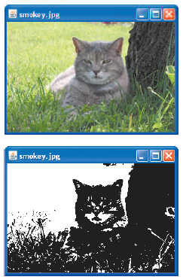
The images Package (continued)
Converting an Image to Black and White:
For each pixel:
Algorithm computes average of the RGB values.
Resets RGB values to black (0) if the average is closer to 0, or 255 (white) if it’s closer to 255.
‹#›
‹#›

Slide 31
Image-Processing Algorithms
Visiting All of the Pixels by Their Positions:
Linear loop structure: visit each element in a sequence or count a sequence using a single loop control variable.
Nested loop structure: each data value in a two-dimensional pixel grid is accessed using the form (<column>, <row>).
‹#›
‹#›

Slide 32

Image-Processing Algorithms (continued)
Visiting All of the Pixels by Their Positions (cont):
A nested loop structure must consist of an outer and an inner loop.
Each loop has a different control variable that iterates over a different coordinate.
Row-major traversal: goes across the row in a grid, prints the coordinate at each column in the row, then moves to the next row.
‹#›
‹#›

Slide 33
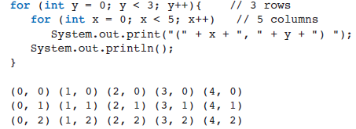
Image-Processing Algorithms (continued)
Visiting All of the Pixels by Their Positions (cont):
Example: print pairs of coordinates in 3x5 grid.
‹#›
‹#›

Slide 34

Image-Processing Algorithms (continued)
Copying an Image:
Use the clone method.
Build and return a new image with the same attributes as the old one.
With an empty string as the filename so the two are independent.
‹#›
‹#›

Slide 35
Image-Processing Algorithms (continued)
Edge Detection:
Edge detection performs the inverse function on a color image:
Removes the full colors to uncover the outlines of the objects in an image.
Plays a critical role in object recognition, which detects images in objects.
Detects edges by looking an luminance of pixels (average of RGB values).
If a pixel’s luminance differs significantly from its neighbors, it is an edge and the pixel is set to black.
‹#›
‹#›

Slide 36
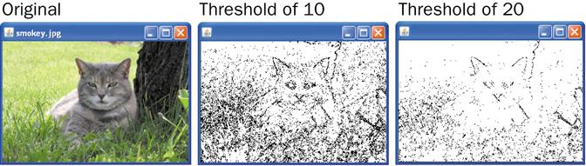
Image-Processing Algorithms (continued)
Edge detection: the original image, a luminance threshold of 10, and a luminance threshold of 20.
‹#›
‹#›

Slide 37
Image-Processing Algorithms (continued)
Reducing the Image Size:
The size and quality of an image displayed on a monitor or printed depends on:
The image’s width and height in pixels.
The display medium’s resolution.
Monitor resolution is measured in pixels per inch (PPI).
When resolution is increased, images are smaller.
When resolution is decreased, images are larger and the quality degrades.
‹#›
‹#›

Slide 38
Image-Processing Algorithms (continued)
Reducing the Image Size (cont):
You can set the resolution of an image when you capture it with a scanner or digital camera.
Reducing an image’s size can improve its performance:
Faster loading on a Web page.
Less space occupied in storage.
If height and with are reduced by N, the number of color values is reduced by N².
‹#›
‹#›

Slide 39
Image-Processing Algorithms (continued)
Reducing the Image Size (cont):
Size reduction preserves an image’s aspect ratio (width to height).
A simple way to shrink an image is to create a new image whose width and height are a fraction of the original.
Reducing throws away some of the pixel information.
The human eye cannot normally detect the loss.
‹#›
‹#›

Slide 40
Image-Processing Algorithms (continued)
Enlarging the Image Size:
You have to add pixels to increase size.
Approximate the color values that would be there if the image was taken at a higher resolution.
Blending the new and old pixels is a complex process.
The human eye can detect the loss in quality.
‹#›
‹#›

Slide 41
Image-Processing Algorithms (continued)
Using the images Package Without a Drawing Window:
Programs do not have to display an image in a window.
Can load, transform, and resave an image.
Run from a terminal command prompt.
The save method overwrites the current file with the changes. saveAs creates a new file.
‹#›
‹#›

Slide 42
Introduction to Digital Sound Processing
Sounds are prepared for computer processing using an analog-to-digital converter.
Samples a sound thousands of times per second.
Each analog input is assigned an integer.
The set of samples is called a sound clip.
The greater the number of samples, the more precise the representation of the original sound.
‹#›
‹#›

Slide 43
Introduction to Digital Sound Processing (continued)
Digital sound and images are different:
Sample values are arranged in a linear sequence, not a grid.
Sound samples are atomic. Each records a sound’s volume at a given moment.
A sequence of sound samples approximates the waveform of the analog sound information.
Positive values above horizontal axis, negative below.
‹#›
‹#›

Slide 44
Introduction to Digital Sound Processing (continued)
Digital sounds’ simple format make their algorithms easier to design.
Programs that compose or edit music:
Increase or decrease the volume.
Dampen hiss or remove static.
Remove or insert segments of other sounds.
Blend sounds, add echoes, or repeat (loop) a sound.
‹#›
‹#›

Slide 45
Introduction to Digital Sound Processing (continued)
Basic Sound-Manipulation Operations:
File formats: WAVE, AU, AIFF, MP3.
Sampling rate: number of samples per second.
A high rate leads to a better sound and larger file.
Sample size: value in bits represent the range of possible integer sample values (amplitudes).
Number of channels: stereo (two), mono (one).
Modern DVDs supports six-channel sound.
‹#›
‹#›

Slide 46
The sounds Package
Supports two interrelated capabilities:
A GUI in which sound clips can be manipulated.
Record new clips, open clip files, save sound clips in files, and play a loaded clip.
Methods for writing programs that manipulate sound clips and display the GUI.
APSoundClip: represents sound as a list of Sample objects.
Sample: A single 16-bit signed integer.
‹#›
‹#›

Slide 47
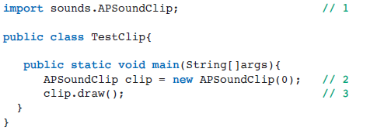
The sounds Package (continued)
Using the sounds package:
Example: import the APSoundClip class, create a new, empty sound clip object with the variable clip, and display the clip’s window with waveform and commands.
‹#›
‹#›

Slide 48
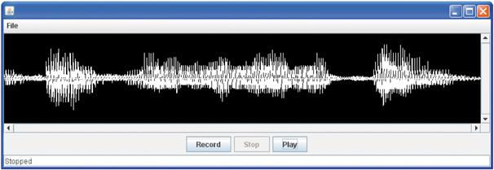
The sounds Package (continued)
A sound clip’s waveform after recording
‹#›
‹#›

Slide 49
The sounds Package (continued)
Adjusting a Sound Clip’s Volume:
Volume is reflected in the amplitude (height and depth) of its waveform at a given point.
To increase or decrease volume, increase or decrease the size of the sample value.
Algorithm resets the value of each sample by multiplying its old value by a given factor.
Greater than 1, volume increases, and vice versa.
‹#›
‹#›

Slide 50
The sounds Package (continued)
Adjusting a Sound Clip’s Volume (cont):
Must address the possibility that samples fall out of the legitimate range.
Use the maximum of the product and the minimum possible sample if the sample is negative.
Use the minimum of the product and the maximum possible sample if the sample is not negative.
‹#›
‹#›

Slide 51
The sounds Package (continued)
Splicing Sound Clips:
Spicing places one clip after another to form a new sound.
New clip represents the concatenation of two other clips, similar to concatenating strings.
A loop visits each sample in a clip and copies its value to the appropriate sample and position in the new sound clip.
‹#›
‹#›

Slide 52
The sounds Package (continued)
Composing Sound Clips:
Blending two sound clips to form a new sound clip so that they play simultaneously.
Must account for unequal length for clips.
‹#›
‹#›

Slide 53
The sounds Package (continued)
Echoing Sound Clips:
An effect where an earlier part of a clip is heard concurrently with the sound at the present.
Algorithm retrieves samples that occur earlier in the clip and blend with sounds that occur later.
An obvious echo has delay between sample pairs.
The inputs are a sound clip and an integer delay.
The resulting sample is a new clip.
‹#›
‹#›

Slide 54
Summary
In this chapter, you learned:
Object-based programming uses classes, objects, and methods to solve problems.
A class specifies a set of attributes and methods for the objects of that class.
A new object is obtained by instantiating its class. An object’s attributes receive their initial values during instantiation.
‹#›
‹#›

Slide 55
Summary (continued)
The behavior of an object depends on its current contents and on the methods that manipulate this state.
The set of a class’s methods is called its interface. The interface is what a programmer needs to know to use objects of a class. The information in an interface usually includes the method headers and documentation about arguments, return values, and changes of state.
‹#›
‹#›

Slide 56
Summary (continued)
A class usually includes a toString method that returns a string representation of an object of the class. This string might include information about the object’s current contents. Java’s print and println methods automatically call this method when they receive an object as a parameter.
‹#›
‹#›

Slide 57
Summary (continued)
Digital images are captured by sampling analog information from a light source, using a device such as a digital camera or a flatbed scanner. Each sampled color value is mapped to a discrete color value among those supported by the given color system.
‹#›
‹#›

Slide 58
Summary (continued)
During the display of an image file, each color value is mapped onto a pixel in a two dimensional grid. The positions in this grid correspond to the screen coordinate system, in which the upper-left corner is at (0, 0) and the lower-right corner is at (width – 1, height – 1).
An enhanced for loop structure is used to visit each pixel in an image.
‹#›
‹#›

Slide 59
Summary (continued)
A nested loop structure is used to visit each position in a two-dimensional grid. In a row-major traversal, the outer loop of this structure moves down the rows using the y-coordinate, and the inner loop moves across the columns using the x-coordinate. Each column in a row is visited before moving to the next row. A column-major traversal reverses these settings.
‹#›
‹#›

Slide 60
Summary (continued)
Image-manipulation algorithms either transform pixels at given positions or create a new image using the pixel information of a source image. Examples of the former type of operation are conversion to black and white and conversion to gray scale. Blurring, edge detection, and altering the image size are examples of the second type of operation.
‹#›
‹#›

Slide 61
Summary (continued)
Digital sound clips are captured by sampling analog information from a sound source, using a device such as a microphone. Each sampled sound value is mapped to a discrete sound value among those supported by the given sound system.
‹#›
‹#›

Slide 62
Summary (continued)
Sound-manipulation algorithms either transform samples at given positions or create a new sound clip using the sample information of a source clip. An example of the former type of operation is adjusting the volume. Echoing and composing sound clips size are examples of the second type of operation.
‹#›
‹#›

